Slide 1
Research and Methodology
Lecture 2

Slide 2
Organization of this lecture
Research and Methodology:
Research defined and described
Some classifications of research
Define and discuss methodology
Description of the research process
Discuss creativity and its role in the research process

Slide 3
Research Defined and Described
“Research is the systematic approach to obtaining and confirming new and reliable knowledge”
  Systematic and orderly (following a series of steps)
  Purpose is new knowledge, which must be reliable
  This is a general definition which applies to all disciplines

Slide 4
Notice that:
“… truth was not used in the definition of research” (p 16)
“This concept of truth is outside of the productive realm of thinking by researchers” (p 16)

Slide 5
Research is not
Accidental discovery :
  Accidental discovery may occur in structured research process
  Usually takes the form of a phenomenon not previously noticed
  May lead to a structured research process to verify or understand the observation

Slide 6
Research is not … cont.
Data Collection
an intermediate step to gain reliable knowledge
collecting reliable data is part of the research process

Slide 7
Research is not … cont.
Searching out published research results in libraries (or the internet)
This is an important early step of research
The research process always includes synthesis and analysis
But, just reviewing of literature is not research

Slide 8
Research is…
Searching for explanation of events, phenomena, relationships and causes
  What, how and why things occur
  Are there interactions?
A process
  Planned and managed – to make the information generated credible
  The process is creative
  It is circular – always leads to more questions

Slide 9
All well designed and conducted research has potential application.
Failure to see applications can be due to:
  Users not trained or experienced in the specialized methods of economic research and reasoning
  Researchers often do not provide adequate interpretations and guidance on applications of the research
  Researchers are responsible to help users understand research implications
  (How?)

Slide 10
Public good
Public research is a public good
  May be more rigorous and objective because it is subject to more scrutiny
Private research may also be rigorous
  But research on a company’s product may be questioned as biased.

Slide 11
Classification of Research
Before classification, we must first define types of research
Different criteria are used to classify research types
(All of these are somewhat arbitrary and artificial)

Slide 12
Basic vs Applied Research
Basic – to determine or establish fundamental facts and relationships within a discipline or field of study. Develop theories … (examples in economics?)
Applied – undertaken specifically for the purpose of obtaining information to help resolve a particular problem
The distinction between them is in the application
  Basic has little application to real world policy and management but could be done to guide applied research

Slide 13
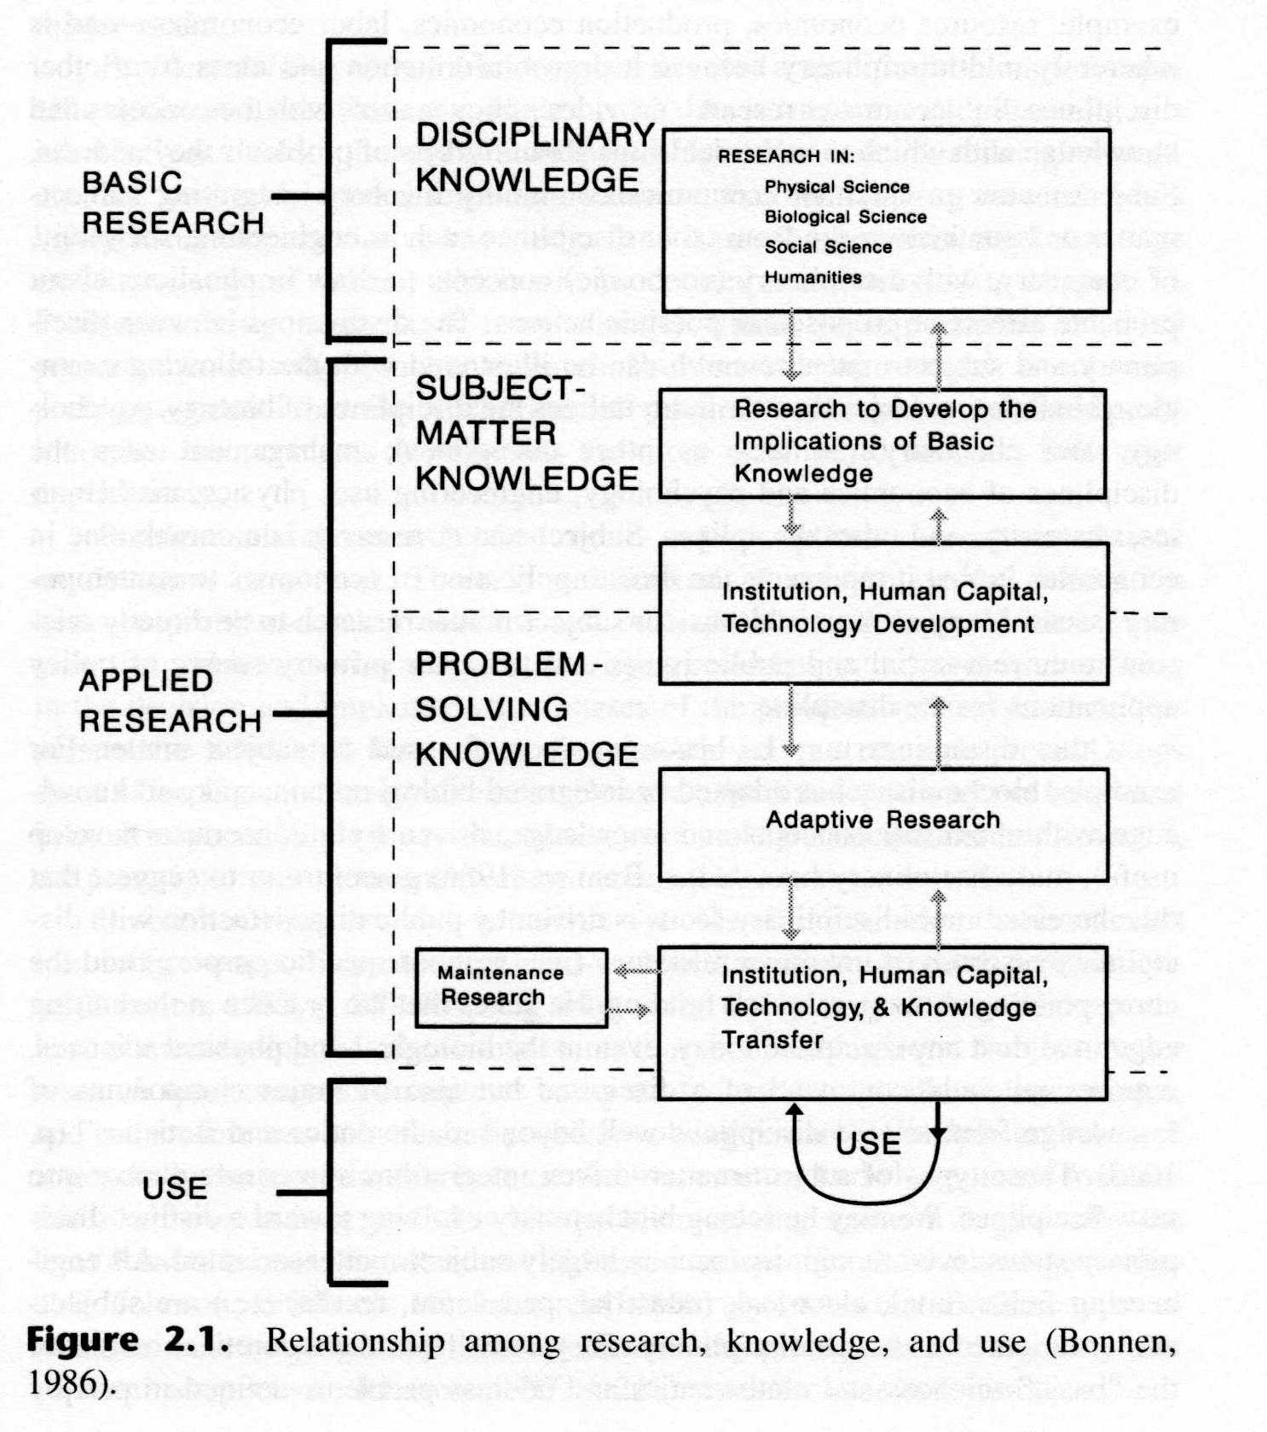
Disciplinary, Subject-matter, and Problem-solving Research (Johnson, 1986)

Slide 14
Disciplinary
designed to improve a discipline
dwells on theories, fundamental relationships and analytical procedures and techniques
In economics, the intended users are other economists
Provides the conceptual and analytical base for other economic research
It is synergistic and complementary with subject matter and problem-solving research

Slide 15
Disciplinary… cont.
Provides the foundations for applied research
Circular as applied research reveals the shortcomings of disciplinary research
Examples of some economic theories?
(supply & demand, price elasticity, consumer utility …)

Slide 16
Subject-matter research
“research on a subject of interest to a set of decision makers “ (p 22)
Tends to follow subject-matter boundaries within a discipline ( eg. resource economics, production economics, labor economics)
Inherently multidisciplinary, drawing information from many disciplines
  eg. consumer economic draws from psychology, natural resource economics from biology, economic policy from political science

Slide 17
Subject-matter research … cont.
Provides policy makers with general knowledge to make decisions about various problems.
A primary source of policy applications for economics
Subject-matter research is a cornerstone in economics – it involves direct application of economics to contemporary issues.

Slide 18
Problem-solving research
Designed to solve a specific problem for a specific decision maker
Often results in recommendations on decisions or actions
Problem-solving research is holistic – uses all information relevant to the specific problem
(while disciplinary research tends to be reductionist)
Disciplinary research is generally the most “durable” (long lasting); problem-solving research the least durable

Slide 19
Analytic vs Descriptive Research
Descriptive Research – the attempt to determine, describe, or identify something
  The intent is often synthesis, which pulls knowledge or information together
Analytic – the attempt to establish why something occurs or how it came to be
All disciplines generally engage in both

Slide 20
Methodology Defined & Described
Methodology and Method are often (incorrectly) used interchangeable
Methodology – the study of the general approach to inquiry in a given field
Method – the specific techniques, tools or procedures applied to achieve a given objective
  Research methods in economics include regression analysis, mathematical analysis, operations research, surveys, data gathering, etc.

Slide 21
Contrast research methodology in economics (the approach to research) to economic methodology (the general approach to economic reasoning and economic concepts)
While these are different they are interdependent ( in the same way as science and research are related)

Slide 22
The Process of Research
The process is initiated with a question or problem (step 1)
Next, goals and objectives are formulated to deal with the question or problem (step 2)
Then the research design is developed to achieve the objectives (step 3)
Results are generated by conducting the research (step 4)
Interpretation and analysis of results follow (step 5)

Slide 23
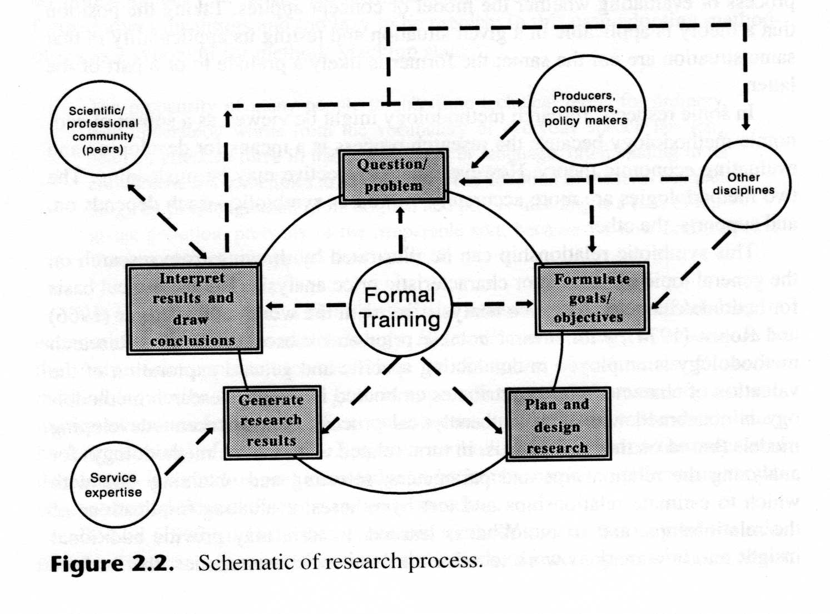





The Process of Research

Slide 24
Creativity in the Research Process
Research is a creative process
“…research includes far more than mere logic … It includes insight, genius, groping, pondering – ‘sense’ … The logic we can teach; the art we cannot” (p 30)
Research requires (or at least works best) with imagination, initiative, intuition, and curiosity.
There are different types of creativity, characteristic of different situations – “applied” and “theoretical” most closely associate with economic research

Slide 25
Fostering Creativity (Ladd 1987)
Gather and use previously developed knowledge
Exchange ideas
Apply deductive logic
Look at things alternate ways
Question or challenge assumptions
Search for patterns or relationships
Take risks
Cultivate tolerance for uncertainty

Slide 26
Fostering Creativity … cont.
Allow curiosity to grow
Set problems aside … and come back to them
Write down your thoughts
  “… frequently I don’t know what I think until I write it”
Freedom from distraction … some time to think.
Creativity may provide the difference between satisfactory and outstanding research.

